Slide 1

Plumber’s Permit Problem
Billy Mejia & Marcus Wade

Slide 2
Plumber’s Problem
1. Connection Authorization Permit – Land Development Div. of City Planning and Development
2. Plumbing Permit (Private Property) – Permits Division of City Planning and Development
3. - Connection Inspection Permit (Sewer) – Water Services
- Water Tap Permit – Water Services
If going into Public Right of Way:
4. Excavation Permit – Public Work
5. Traffic Control Permit – Public Works

Slide 3
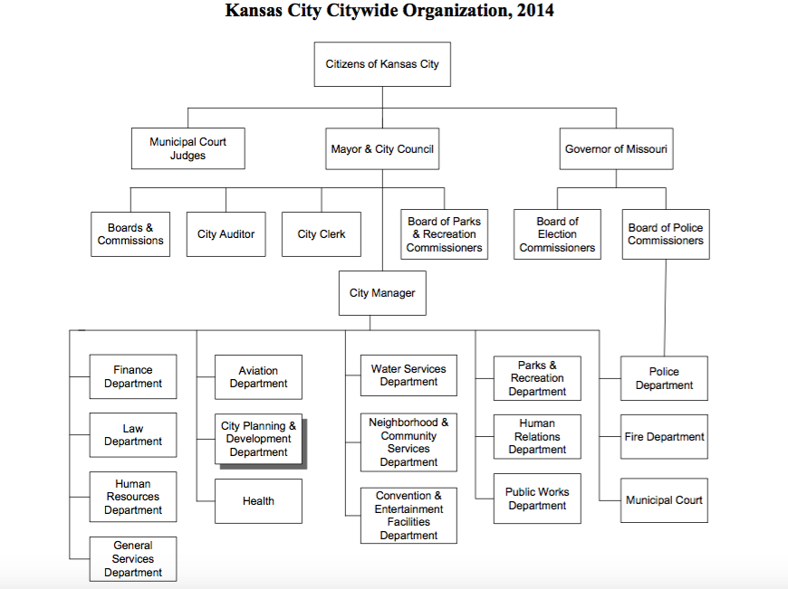

Slide 4
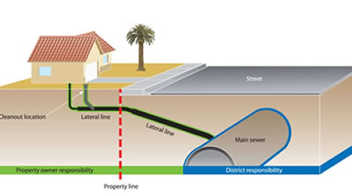
Kansas City

Slide 5
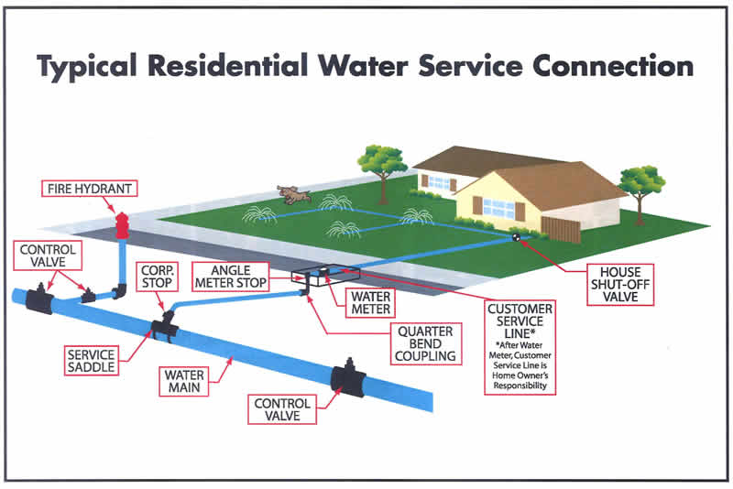

Slide 6
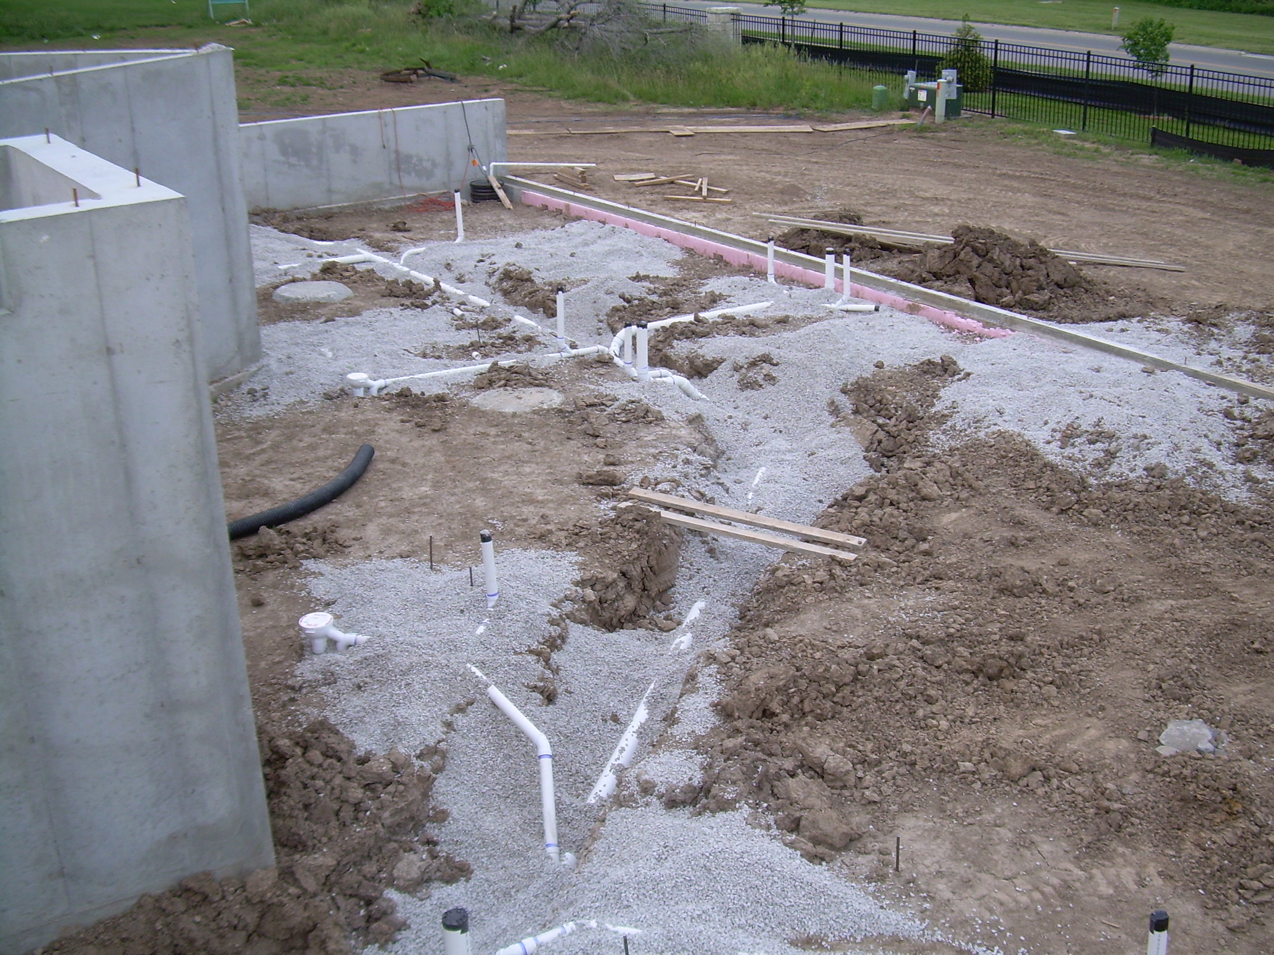

Slide 7
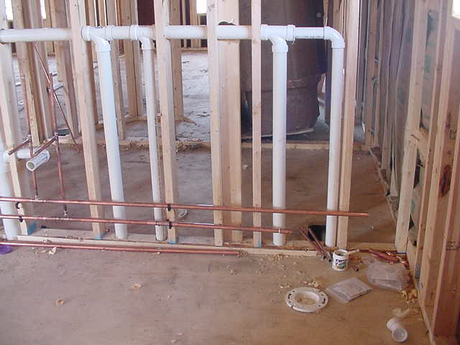

Slide 8


Slide 9
Reason for current system
The best way for the separate Departments and Divisions to communicate was for the Contractor to bring the application/permit around with them initiate the next steps
There were no computers and very few phones in City Hall
Departments were not able or willing to communicate what has already occurred

Slide 10
Framework within Kansas City Ordinances
Ch. 18: Buildings and Building Regulations
Art. I – General; §16 – Requires permits for interior plumb work
Art. VII. – Plumbing Code
Art. VIII. – Private Sewage Disposal
Ch. 26: Fire Prevention & Protection
Ch. 60: Sewers & Sewage Disposal
Art. II – Sewer and Drain Construction and Connection
§27 – Requires permit and inspection to connect to city sewer
Ch. 64: Streets, Sidewalks, and Public Places
Art. I - General
§4 – Authorization for work in the right of way
Art. IV – Excavations
§113 – Requires permit from Public Works to excavate in right of way.
§115 – Excavating in right of way requires Traffic Control Permit from Public Works
Ch. 78: Water
Art. I General - §21 Permit Required from Water Services to connect to main

Slide 11
What is the Ideal Solution?
Plumbers
City Hall
Not required to come into City Hall
Chosen by many (Permit Services)
One Application to be filled out
Easier communication between Departments
Notification when Department should begin work
(Previous department is complete)

Slide 12
EnerGov
When implementing EnerGov will connect all the departments using software that will track the entire permitting, inspecting, and building process.
Departments will be able to notify other Departments or the customer that its work is complete and ready for the next action to be taken
All of this can be done without a visit to City Hall
Payments can be assessed and paid, all online
The fee will even proportionately allocate to the originating Department

Slide 13
Areas for Further Work
- Question & Answer
- Permit Consolidation

Slide 14
Question & Answer
While EnerGov can eliminate many of the process issues, there is still a need to educate the customer of what they’ll need to complete their project.
A Question & Answer decision engine could be used to identify the various permits a customer would need, and serve as an educational tool.

Slide 15
Possible Questions for Q & A
Are you licensed with the City to perform plumb work?
What type of structure is being constructed?
Is the project infill in a subdivision that has been previously developed?
Is the project in a recently organized and developed subdivision?
Is there an existing service line to the water main?
Is there an existing service line to the sewer?

Slide 16
Possible Questions for Q & A
Will construction occur in a public right of way?
Will construction affect traffic on a public street?
Is the owner of the property performing the interior plumb work?

Slide 17
Permit Consolidation
Connection Inspection Permit could be eliminated with implementation of EnerGov
Potential to consolidate other permits is limited by the various roles that issuing departments play
May require ordinance changes or changes in department responsibilities

